Slide 1

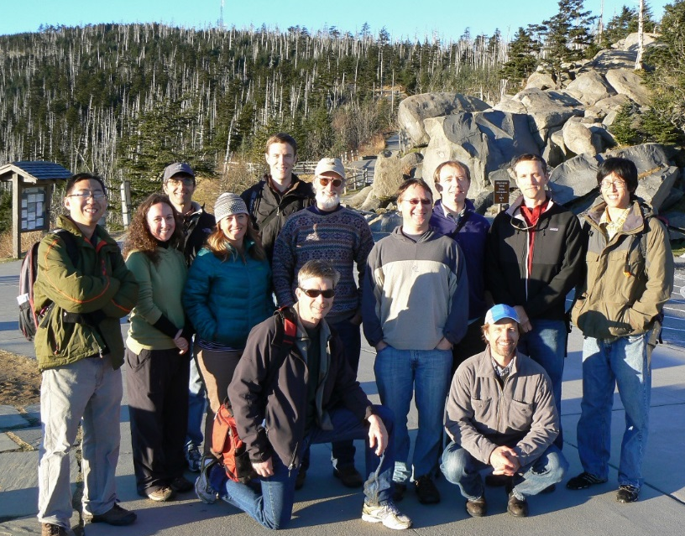




Landscape Climate Change Vulnerability Project (LCC-VP)
Montana State University:
Andy Hansen, Nate Piekielek, Tony Chang, Linda Phillips
Woods Hole Research Center:
Scott Goetz, Patrick Jantz, Tina Cormier, Scott Zolkos
NPS I&M Program:
Bill Monihan and John Gross
NPS / Great Northern LCC:
Tom Olliff
CSU Monterey Bay / NASA Ames:
Forrest Melton, Weile Wang
Conservation Science Partners:
Dave Theobald
Clingman’s Dome, Great Smoky Mountain NP
NASA Applied Sciences Program
(NNH10ZDA001N - BIOCLIM)
NPS I&M Program
Notes:
1

Slide 2
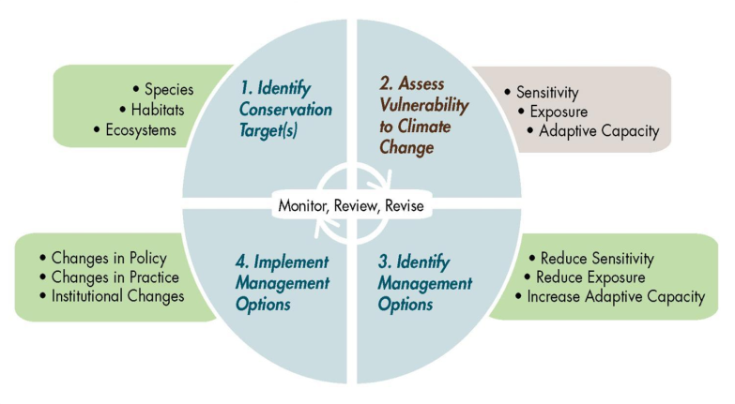
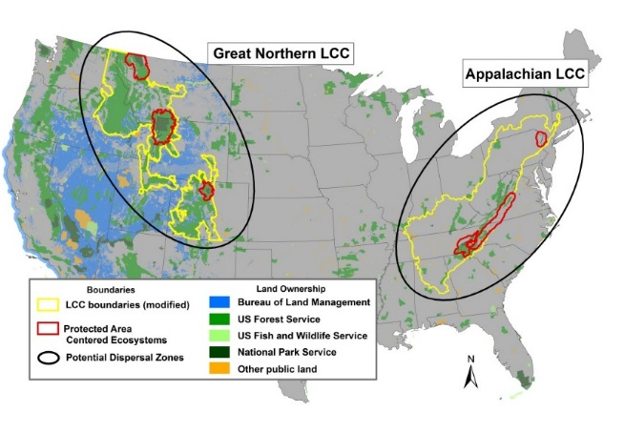
Goals and Objectives
Goal
Demonstrate the four steps of a climate adaptation planning strategy in two LCCs using NASA and other data and models.
Glick et al. 2011. Scanning the Conservation Horizon: A guide to climate change vulnerability assessment. National Wildlife Federation, Washington, D.C.
Notes:
2
Our goal is to demonstrate in two lccs.

Slide 3

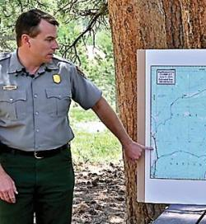
The “customers”
Dan Wink, YNP Superintendent
Ben Bobowski, Chief of Resources, Rocky Mountain National Park
Notes:
3
Our goal is to demonstrate in two lccs.

Slide 4
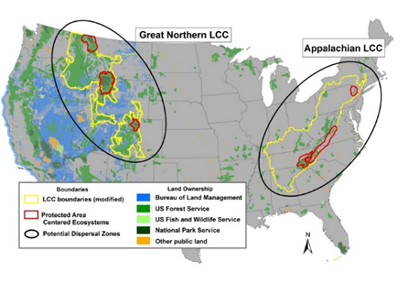
Topics
1900-2010, 2010-2100
Climate change
Ecosystem processes
Vegetation responses
Protected-area Centered Ecosystem - The surrounding area essential to maintaining natural processes and native populations within the Protected Area.
Hansen et al. 2011.

Slide 5
Assess Vulnerability
Climate change
Ecosystem and tree species climate tolerances
Exposure
Sensitivity
Dispersal capability
Projected response
Potential
Impact
Adaptive
Capacity
Priority for management
Vulnerability
Notes:
5
Our goal is to demonstrate in two lccs.

Slide 6
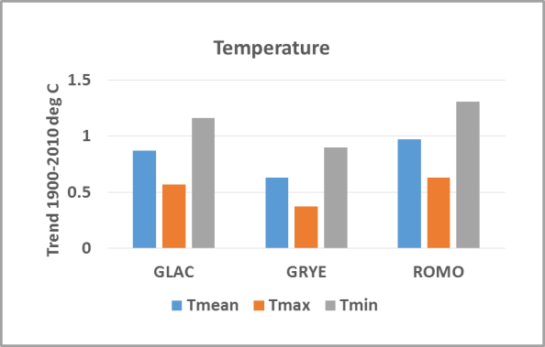
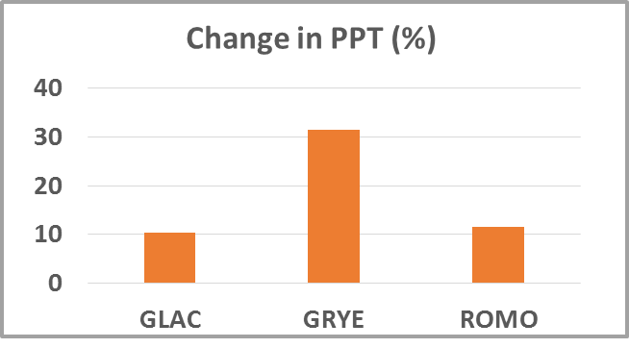
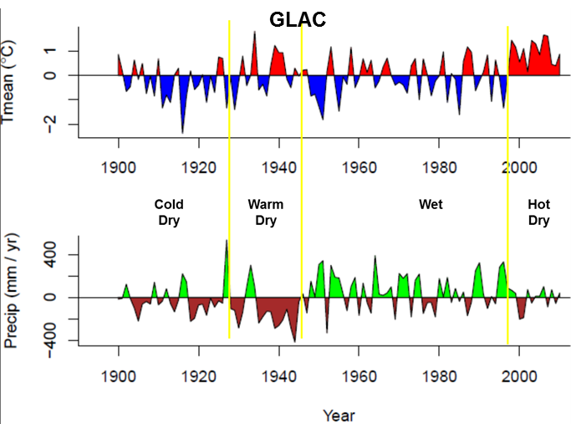
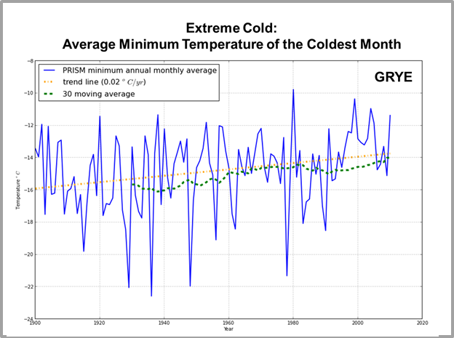
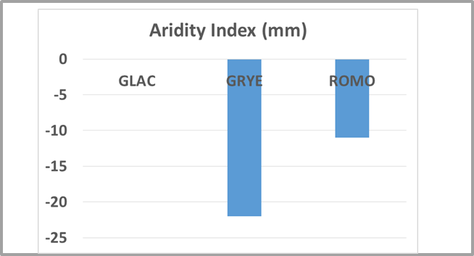
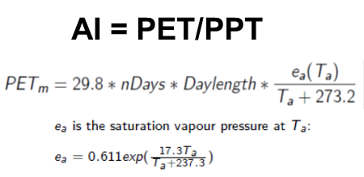
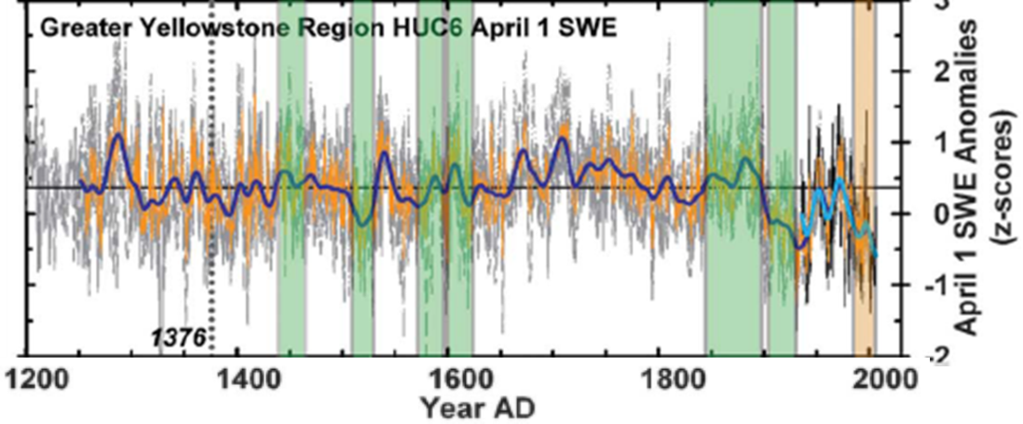
Climate Change 1900-2010
GNLCC
Pederson et al. 2011

Slide 7
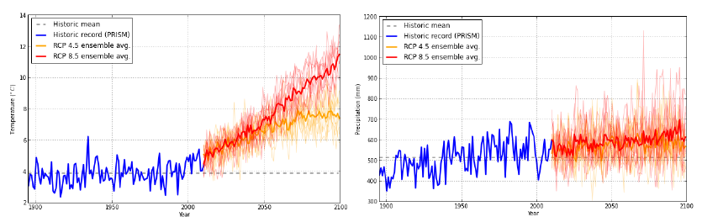
Future Climate
GYE PACE
CMIP5 AR5, 20 GCM ensemble average
Reference period: 1980-2005 average
Change in temperature by 2100 (°C)
RCP 4.5 | RCP 8.5
3.0 | 7.0
Change in PPT (mm) by 2100
RCP 4.5 | RCP 8.5
60 (7.5%) | 130 (16.3%)
Context: Mean July temperature across North America since the end of the last ice age 14 000 years ago varied ~5 ⁰C (Viau et al. 2006).

Slide 8
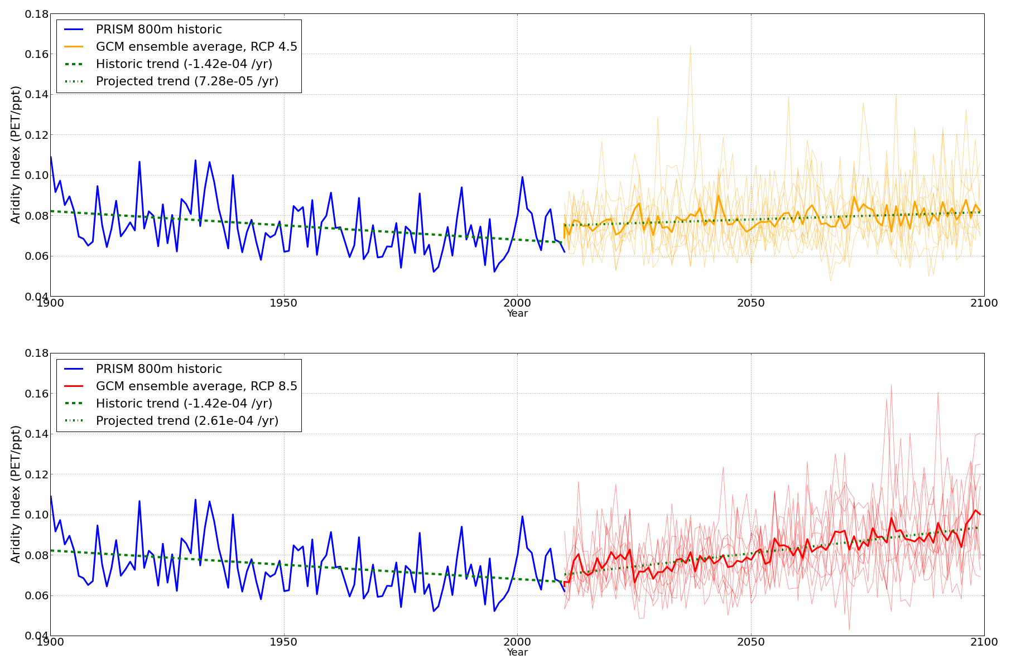
Future Climate
GYE PACE
CMIP5, 8 GCM ensemble average, 800 m
Aridity Index
RCP 4.5
RCP 8.5

Slide 9
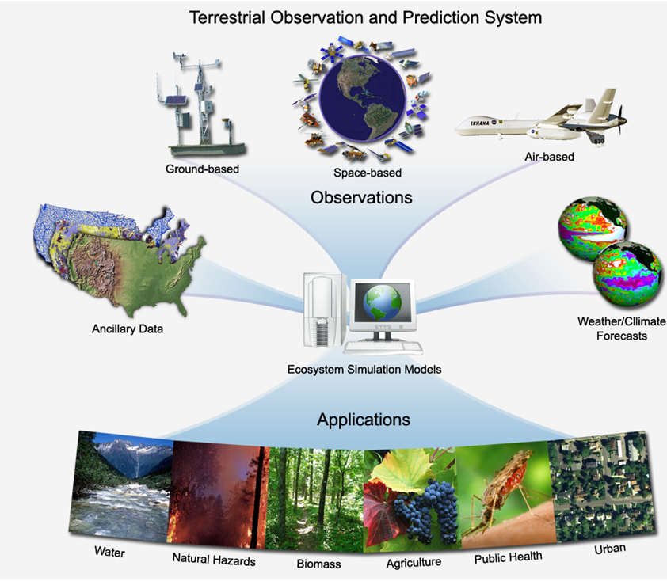
Projected Ecosystem Processes
WRCP CMIP5 Scenarios
US NED Elev
STATSGO soils
Convert to MODIS MCDQ1 land cover classes
TOPS
BIOME-BGC
MODIS land cover, snow cover, NDVI, LAI/FPAR & NOAA NCDC met data
SERGoN land use change model
Simulations:
1950-2010
2010-2100
Snow Pack
Soil Moisture
Watershed outflow
Primary Productivity
Notes:
9
We are doing exposure and sensitiity via hindcasting and forecasting. Climate and land use as driven by ipcc scenariors drive ecol process models. All this is imput into the biodiv focus – veg types or ecol system types.

Slide 10
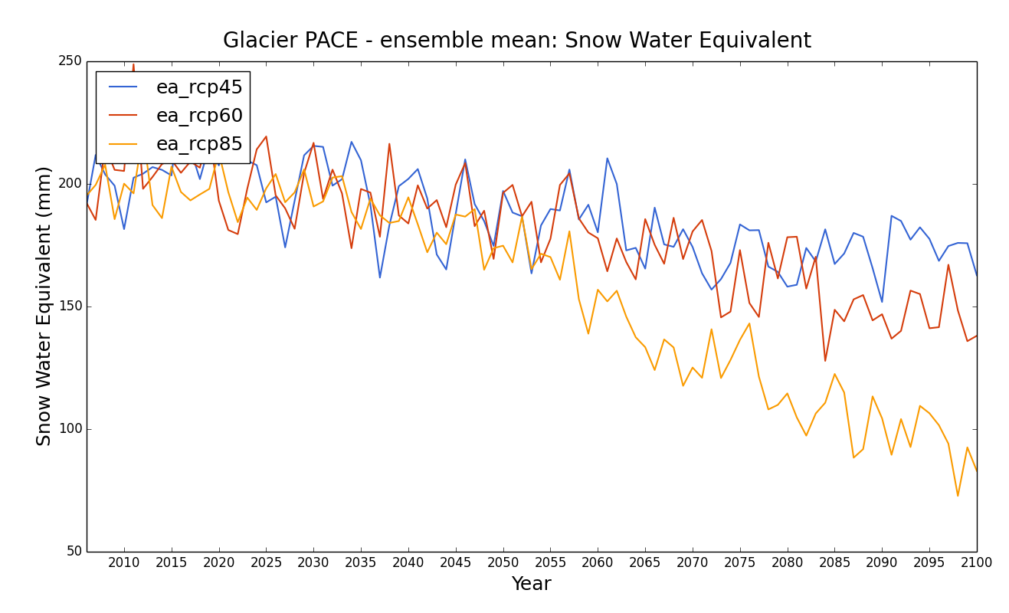
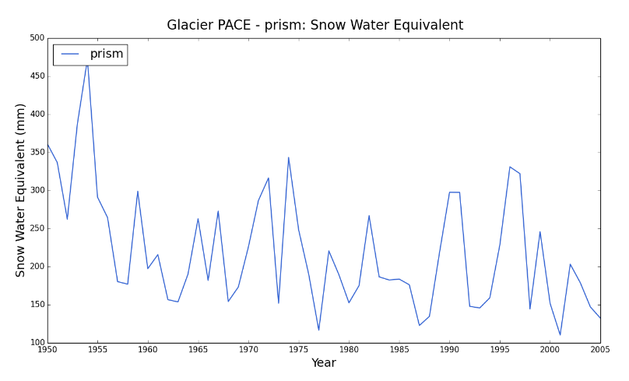
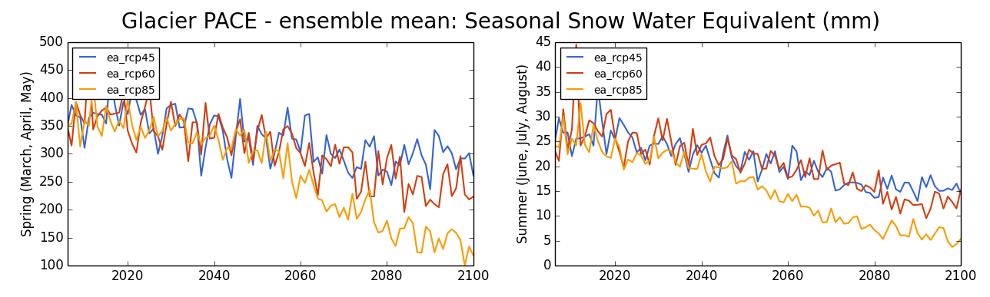
Projected Ecosystem Processes
GLAC PACE
CMIP5, 20 GCM ensemble average, 800 m

Slide 11
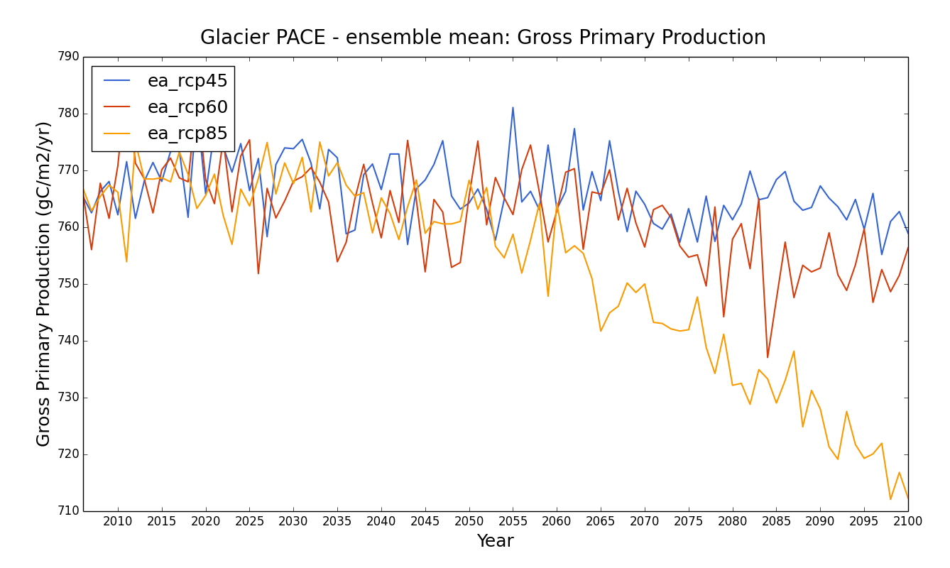
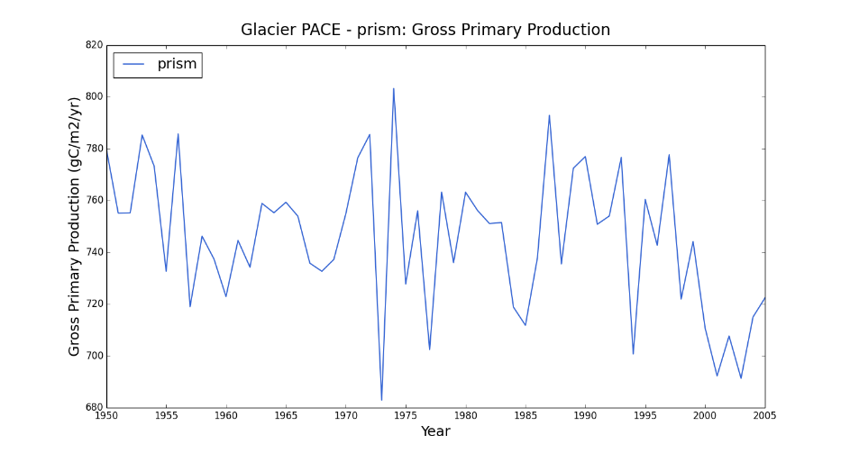
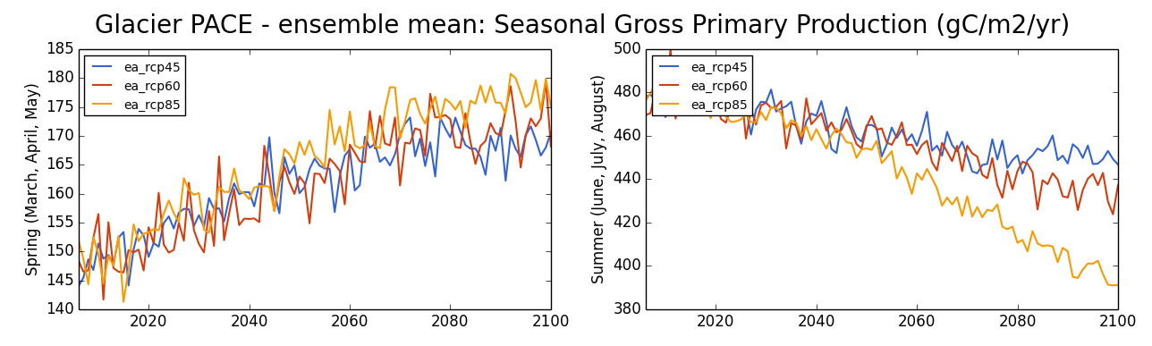
Projected Ecosystem Processes
GLAC PACE
CMIP5, 20 GCM ensemble average, 800 m

Slide 12
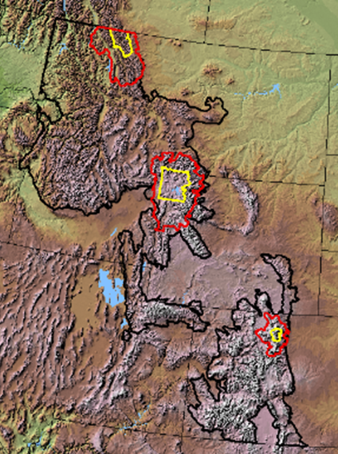
Vegetation Response to Climate Change
GNLCC
Synthesis of Published Studies
Study | Approach | GCMs / scenarios | Vegetation Units
Jiang et al. 2013 | DGVM (CLM4) | CESM A2, 8 Initial SST Conditions | Plant Functional Types
Rehfeldt et al. 2012 | Climate niche models | CGCM3, GFDLCM21, HADCM3 / A1B, A2, B1, B2 | Biomes
Crookson et al. 2010 | Simulation model | CGCM3, GFDLCM21, HADCM3 / A2, B1 | Tree species
Coops and Waring 2011 | Simulation and climate niche models | CGCM3 / A2, B1 | Tree species
Bell et al. 2014 | Climate niche models | 16 GCMS / A2, B1 | Tree species

Slide 13
Jiang et al. 2013
Vegetation Response to Climate Change
Dynamic Global Vegetation Model (CLM4)
Plant Functional Types, 222 km x 250 km resolution
CESM A2, 8 Initial SST Conditions
Change in coverage of Plant Functional Types
Spatial distribution of changes in needleleaf evergreen tree coverage between 2070–99 and 1961–90
Causes in model:
Heat stress – reduces photosynthesis and increases respiration
Negative water balance in summer – reduces photosynthesis

Slide 14
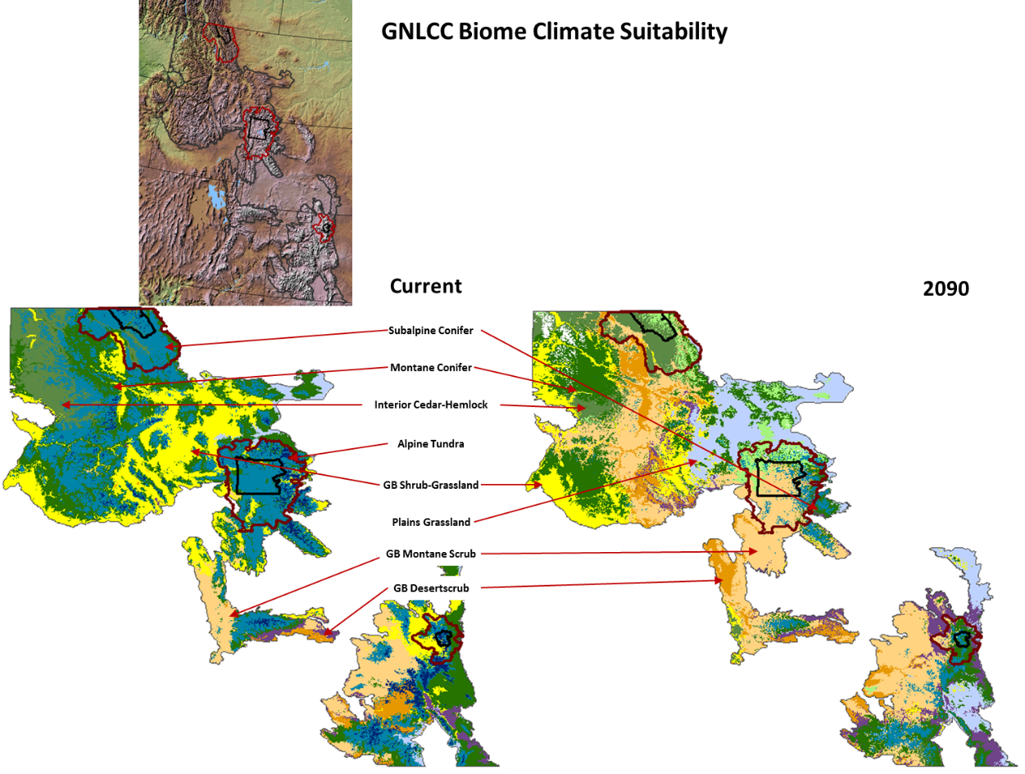
Vegetation Response to Climate Change
Projected Biome Suitability
Data from Rehfeldt et al. 2012
Current
2090

Slide 15
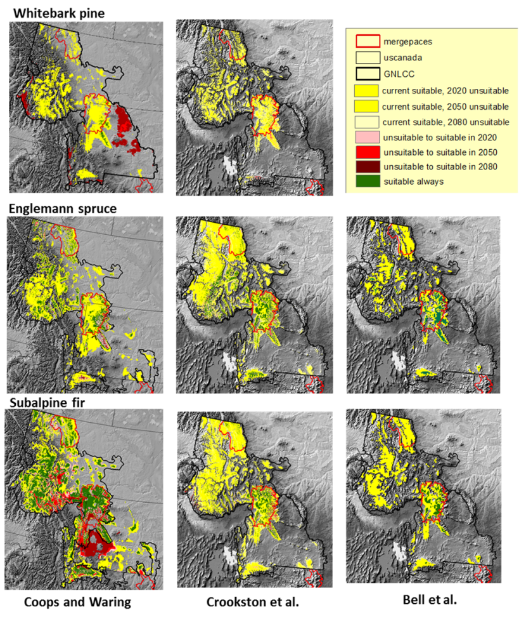
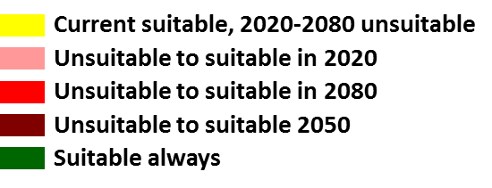
Vegetation Response to Climate Change

Slide 16
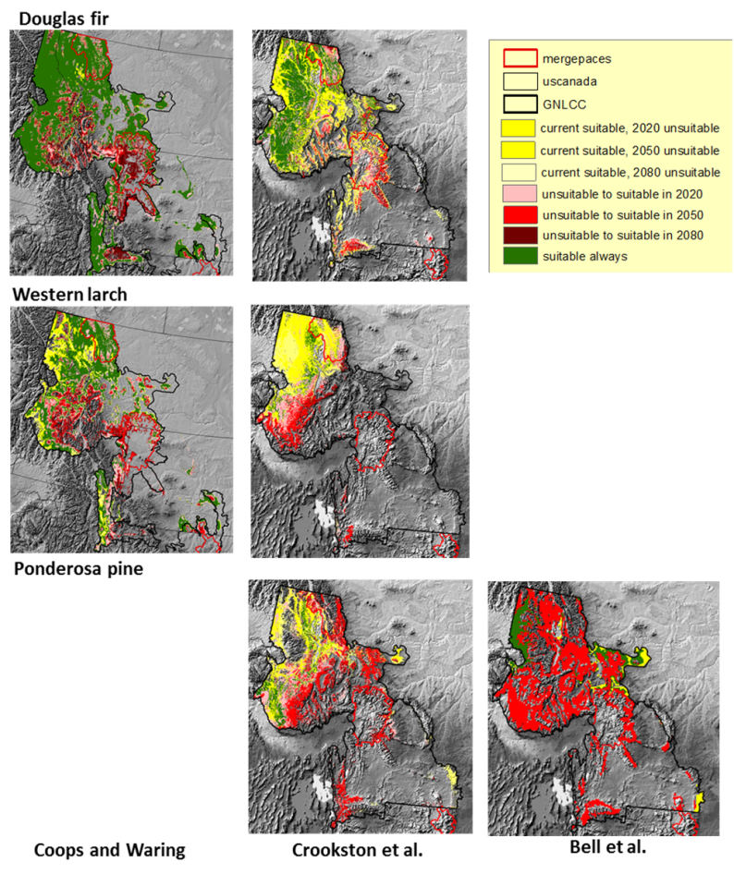
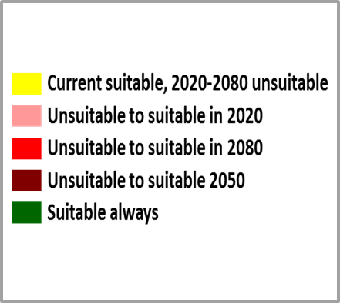
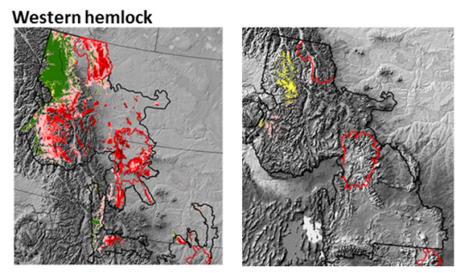
Vegetation Response to Climate Change

Slide 17
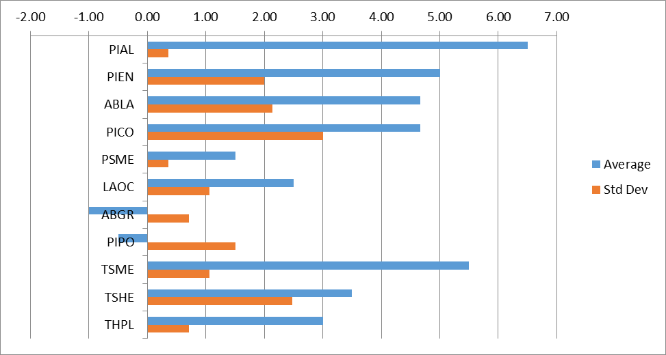
Vegetation Response to Climate Change
Time Period | Metric | Units | Vulnerability Ranking
Current Period | Area of suitable habitat | Percent of study area | 5: Very high (<10% of area) 4: High (10<30% of area) 3: Medium (30<50% of area) 2: Low (50<75% of area) 1: Very low (>=75% of area)
Late century (e.g., 2070-2090) | Loss of reference-period suitable habitat | Percent loss of area from the reference period | 5: Very high (>75%) 4: High (>50-75%) 3: Medium (>30-50%) 2: Low (>10-30%) 1: Very low (<=10%)
 | Naturally colonizable newly suitable habitat by 2070-2090 | % gain in suitable habitat <=30 km from ref suitable) | 0: very low gain (0<10%) -1: low gain (10<50%) -2: mod gain (50<100%) -3: large gain (100<150%) -4: very large gain (>=150%)
 | Newly suitable habitat by 2070-2090 requiring assisted migration | Percent gain in suitable habitat >30 km from ref suitable) | 0: low gain (0<20%) -1: mod gain (20<100%) -2: large gain (>100%)
Vulnerability Assessment
Averaged scores among studies

Slide 18
Vegetation Response to Climate Change
Habitat Suitability Modeling in GYE
9 Tree Species in GYE
Response Data
Tree species presence
2,569 data points (936 presence, 1,633 absence) from FIA, GYCC, WLIS, GYRN I&M
Predictor Data
PRISM climate (19 variables)
Monthly water balance using Thornthwaite equation (10 variables)
Parent material, soil water-holding capacity, topography (10 variables)
Analyses
Done within the North Central Climate Sciences Center Software for Assisted Habitat Modeling (SAHM) VisTrails package
Four statistical techniques: Boosted Regression Trees, Logistic Regression, Multivariate Adaptive Regression Splines, and Random Forest
Detailed diagnostics.

Slide 19
Vegetation Response to Climate Change
Results: Ecologically meaningful habitat predictors
GYE PACE
 | August deficit (PET-AET) | April snowpack | % sand | June soil moisture | Rock Volume | Solar radiation | Topo Wetness Index
Sagebrush | + | - | o | + | + | + | o
Lower treeline | o | - | o | o | + | o | o
Montane | +/- | +/- | - | +/- | o | - | -
Upper treeline | - | + | - | - | o | + | +

Slide 20
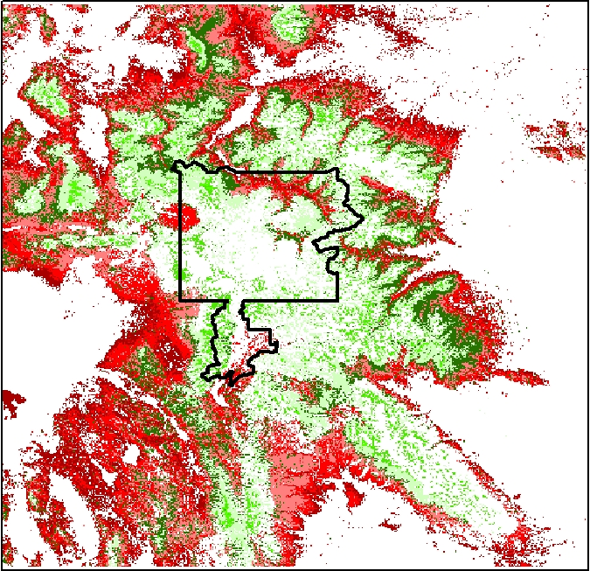
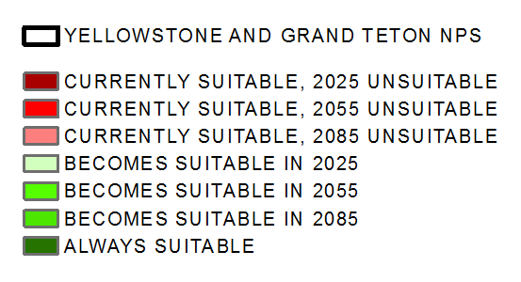
Vegetation Response to Climate Change
Results: GYE PACE
CMIP5, 8 GCM ensemble average, 800 m
RCP 8.5
Increasing suitability for Sagebrush and Juniper across study area
Yellowstone plateau remains unsuitable under more pronounced warming and drying (RCP 8.5).
Upper treeline suitability exhibits contraction to higher elevations where soil conditions (bare rock) will not likely support them in many locations despite model results.
Douglas Fir

Slide 21

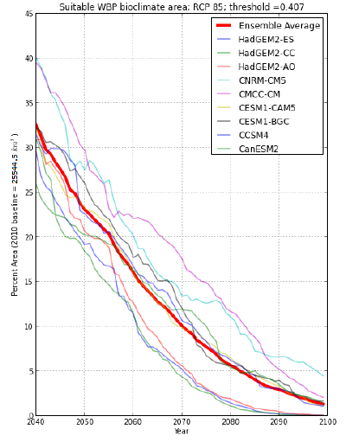
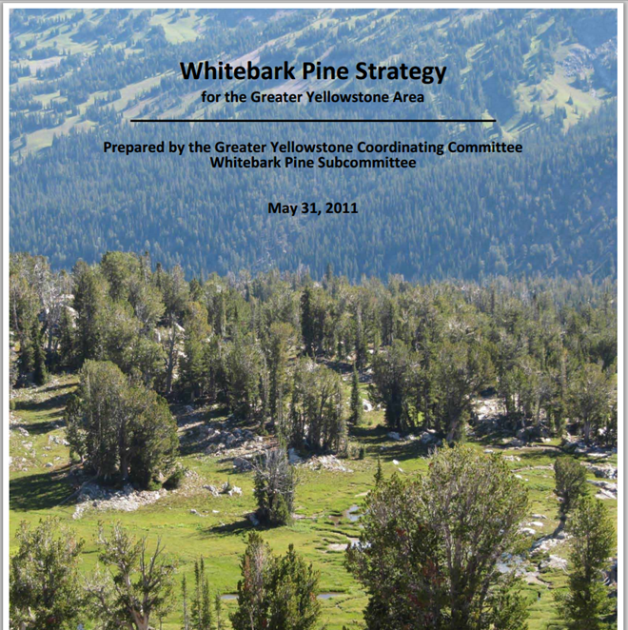
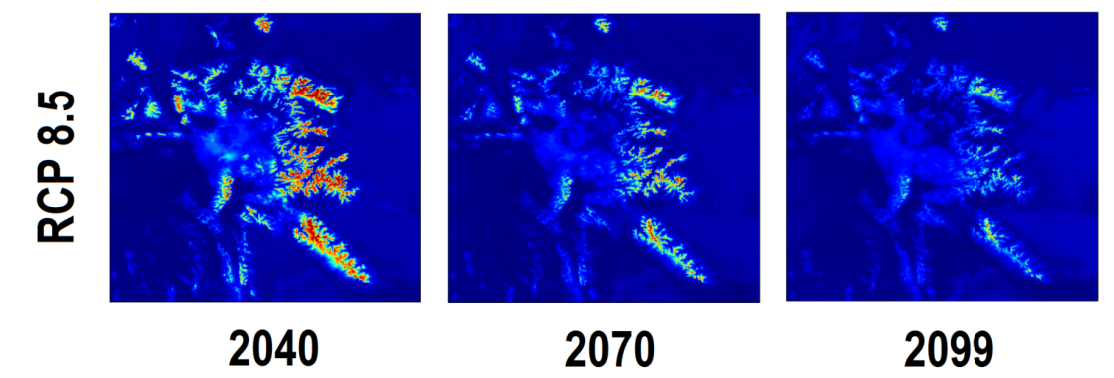
Vegetation Response to Climate Change
Whitebark Pine in GYE

Slide 22
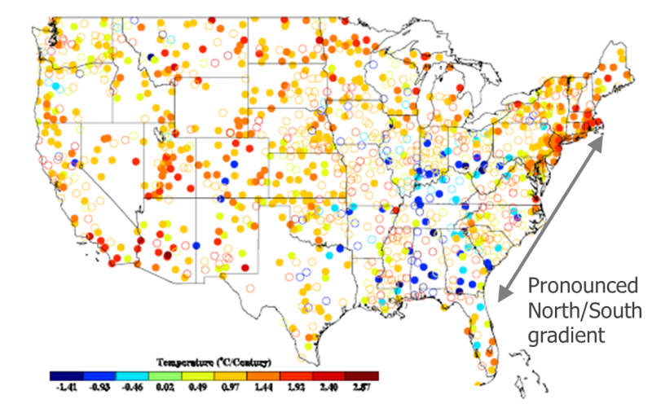
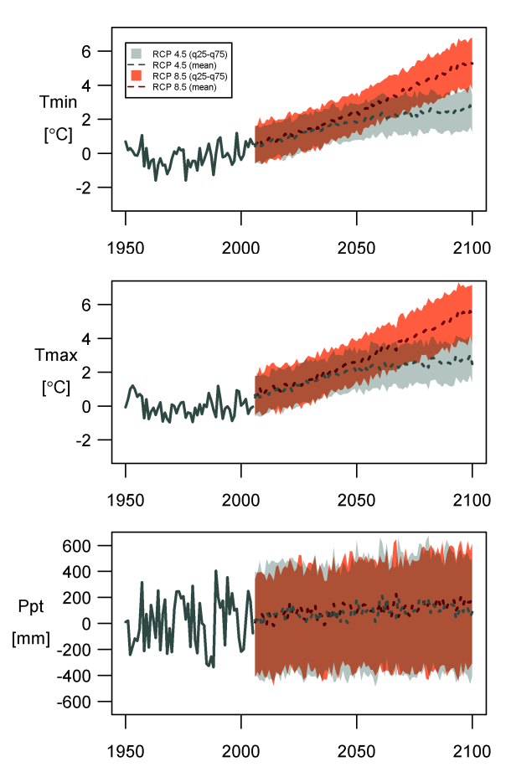
Climate Change
APLCC
Temperature Trends from 1898 – 2008 (ºC/century)
NASA NEXDCP30 Projections
GRSM PACE
PRISM – 1895 – 2005, Tmin trend
GRSM PACE

Slide 23
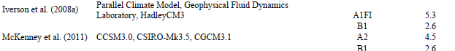
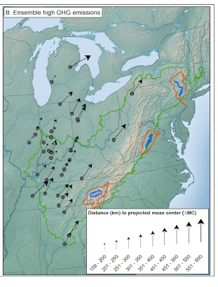
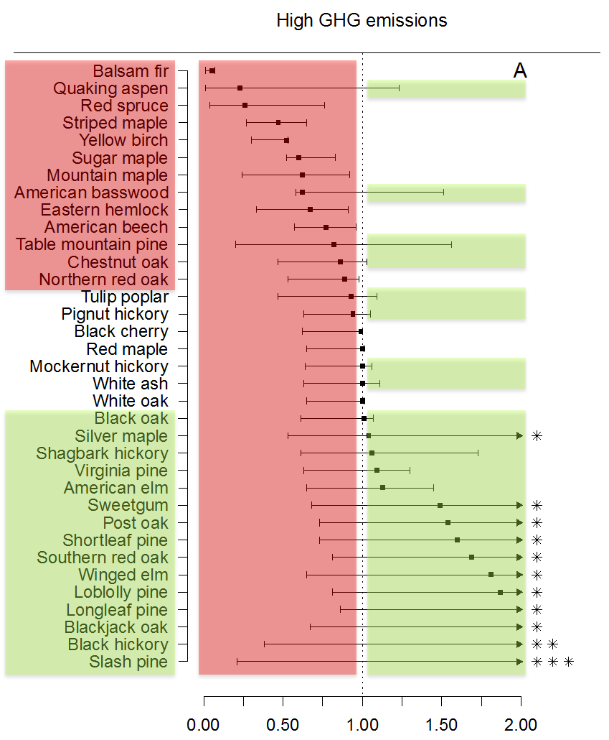
Vegetation Climate Suitability
APLCC
mean = 350 km
Magnitude of Shift in Projected Mean Center for 35 Tree Species
Change in Suitable Habitat Space

Slide 24
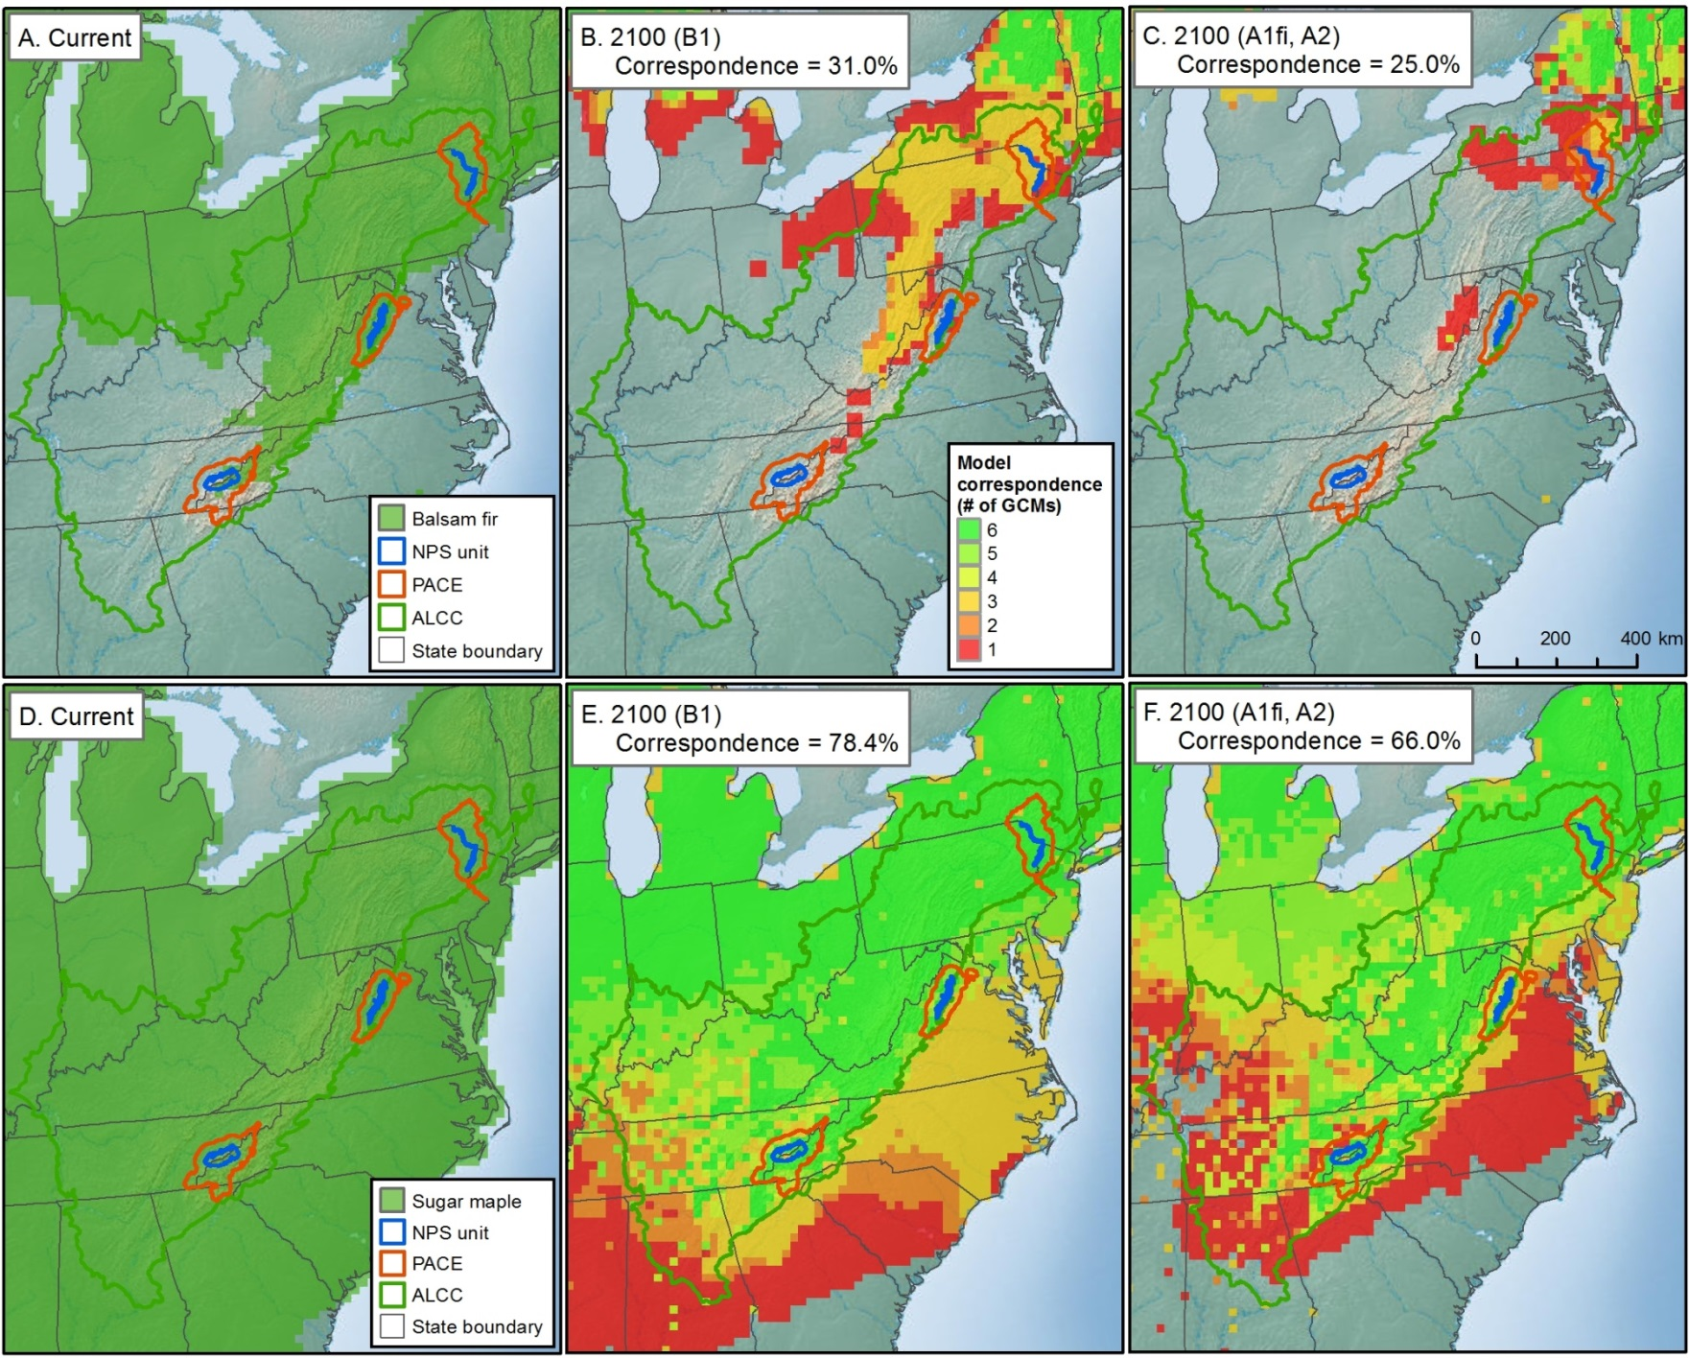
Vegetation Climate Suitability
APLCC
Projected location of suitable climate at present and at 2100 and level of agreement among 6 GCMs
Balsam fir
Sugar maple

Slide 25
Vegetation Climate Suitability
APLCC: New Modeling
Bioclimatic Velocity of Ecological Systems
- Spruce-Fir
- Cove Hardwood
- Northern Hardwood
- Oak Hickory
- Hemlock
- Montane Alluvial
- Mixed Mesophytic
- Pine-Oak
Species Distribution Models
Group 1 – Low correspondence in existing distribution models. New models and uncertainty assessment needed.
- American Basswood
- Quaking Aspen
- Table Mountain Pine
Group 2 – High correspondence in projections of loss. Higher resolution modeling needed for spatial vulnerability assessment.
- Balsam Fir
- Red Spruce
- Sugar Maple

Slide 26
Goals and Objectives
Goal
Demonstrate the four steps of a climate adaptation planning strategy in two LCCs using NASA and other data and models.
Glick et al. 2011. Scanning the Conservation Horizon: A guide to climate change vulnerability assessment. National Wildlife Federation, Washington, D.C.
Notes:
26
Our goal is to demonstrate in two lccs.

Slide 27
Leverage With Other Funding Sources
Montana EPSCoR. Implementing LPJ-GUESS, a DGVM configured for regional application to the GYE
North Central Climate Sciences Center. Foundational Science Team: Ecological impacts
North Central Climate Sciences Center. Informing implementation of the GYCC’s WBP strategy based on climate sciences.
NASA LCLUC. Downscaling IPCC land use scenarios for global change adaptation planning in mountains. Proposed.
IUCN and Wildlife Conservation Society. Application to World Protected Areas. Envisioned
Notes:
27
Our goal is to demonstrate in two lccs.

Slide 28
Decision Support Products
Prepare results as NPS resource briefs;
  e.g., GYE Climate Primer
Document methods as NPS Standard Operating Procedures
Serve key data sets and modeling tools
Policy Documents
  e.g., Olliff et al. In Prep. Responding to climate change in the NPS Intermountain Region: A Guide to Developing Park-based Adaptation Strategies. Natural Resource Report NPS/IMRO
Convene expert panel for vulnerability assessment
Book; Agency and peer-reviewed journal publications
  e.g., Yellowstone Science issue on climate change
Methods and products are being handed off to the NPS Inventory and Monitoring Program and the North Central Climate Sciences Center

Slide 29
Publications
Peer Reviewed
Hansen, A.J., N. Piekielek, C. Davis, J. Haas, D. Theobald, J.E. Gross, W.B. Monahan, T. Olliff, S. W. Running. 2014. Exposure of US National Parks to land use and climate change 1900-2100. Ecological Applications 24: 484-502.
Monahan WB, Cook T, Melton F, Connor J, Bobowski B. 2013. Forecasting Distributional Responses of Limber Pine to Climate Change at Management-Relevant Scales in Rocky Mountain National Park. PLoS ONE 8(12): e83163. doi:10.1371/journal.pone.0083163
Piekielek, N.B. and A.J. Hansen. 2012. Extent of fragmentation of coarse-scale habitats in and around US National Parks. Biological Conservation 155:13-22.
Powell, S.L., A.J. Hansen, T.J. Rodhouse, L.K. Garrett, J.L. Betancourt, et al. 2013. Woodland Dynamics at the Northern Range Periphery: A Challenge for Protected Area Management in a Changing World. PLoS ONE 8(7): e70454. doi:10.1371/journal.pone.0070454
Theobald, D.M., S.E. Reed, K. Fields, & Michael Soule´. 2012. Connecting natural landscapes using a landscape permeability model to prioritize conservation activities in the United States. Conservation Letters. 5: 123–133.
Theobald, D.M. 2013. A general model to quantify ecological integrity for landscape assessments and US application. Landscape Ecology 28(10):1859-1874.
Theobald, DM. 2014. Development and applications of a comprehensive land use classification and map for the US. PLOS ONE. DOI: 10.1371/journal.pone.0094628.
Thrasher, B., J. Xiong, W. Wang, F. Melton, A. Michaelis, R. Nemani. 2013. Downscaled climate projections suitable for resource management. Eos 94(37) 321-323.
Six manuscripts in review or in prep.
Policy Documents
Gross. 2012. Ecological consequences of climate change: mechanisms, conservation, and management. Book Review, Journal of Wildlife Management 76:1102-1103
Gross, J.E., A.J. Hansen, S.J. Goetz, D.M. Theobald, F.M. Melton, N.B. Piekielek, and R.R. Nemani. 2012. Remote sensing for inventory and monitoring of the U.S. National Parks. Pages 29-56 in Y.Q. Yang (ed.), Remote Sensing of Protected Areas. Taylor & Francis, Boca Raton, FL.
Gross, J.E., and E. Rowland. In press. Understanding climate change impacts and vulnerability. Pp. xxx-xxx in B. Stein et al. (eds.), Climate-Smart conservation: putting adaptation principles into practice. National Wildlife Federation, Washington, DC.

Slide 30
Acknowledgements
NASA Applied Sciences Program (Grant 10-BIOCLIM10-0034)
NSF EPSCoR Track-I EPS-1101342 (INSTEP 3)
NASA Land Cover Land Use Change Program
North Central Climate Sciences Center

